Slide 1
TMS–EMG toolbox, user manual
Lari Koponen
2021-04-21

Slide 2
Overview
EMG
(ExG)
2N+1 electrodes
Proprietary connector
TrigIN
PARTICIPANT
TMS–EMG toolbox connects
TMS device (MagVenture MagPro)
EMG amplifier (BrainVision ExG)
On-line TMS–EMG analysis
Neuronavigation
(BrainSight)
TrigIN
(optional) BNC cable
Footswitch
(optional)
Trigger IN box
TMS
(MagPro)
BNC cable
TrigOUT
USB cable
PC, with:
Brain Vision Recorder (software)
TMS–EMG toolbox (MATLAB app)
COM2
* Or, a USB-to-serial adapter and a serial cable, works too
** For the adapter on current computer, COM3; for the port on the motherboard COM1
Serial cable*
COM_**

Slide 3

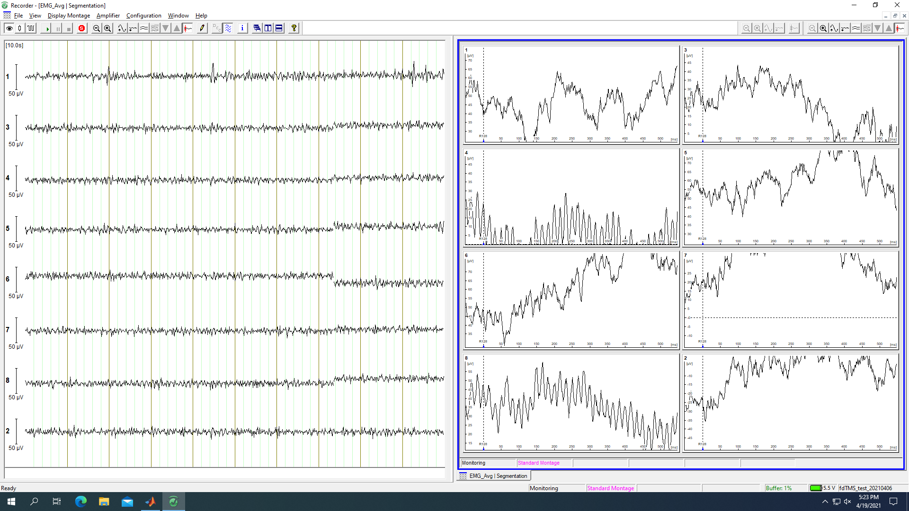
Usage 1/5
Recommended use pattern
Turn on TMS device
Turn on ExG
Start BrainVision recorder
SEND TEST PULSES
BrainVision Recorder sometimes does not capture the first trigger after turn-on, we do not want this to occur during recording

Slide 4
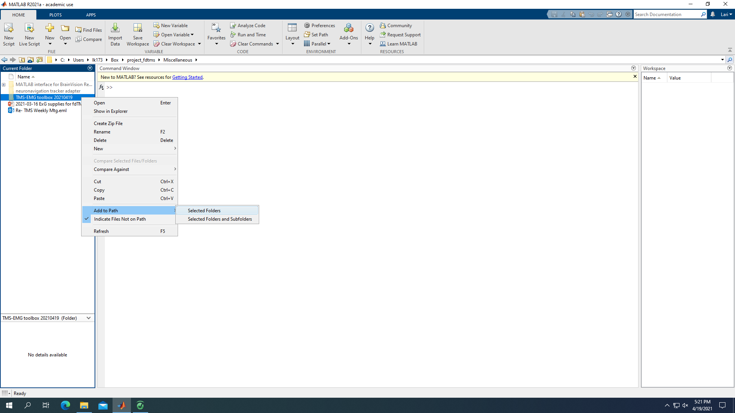
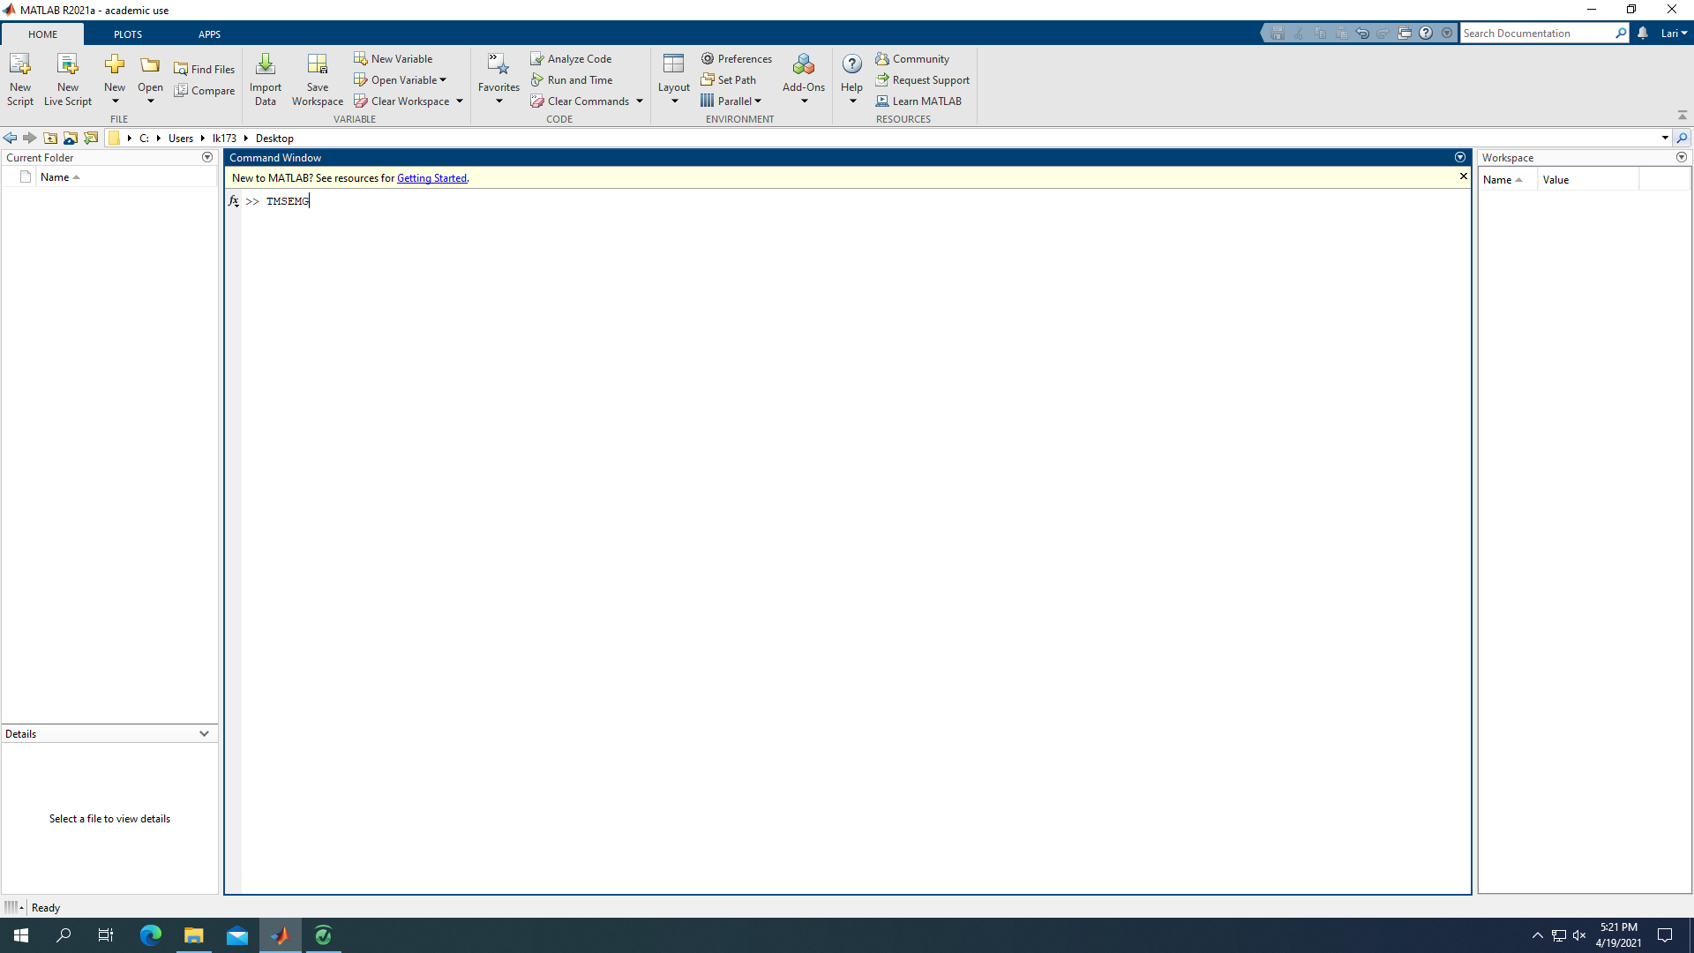
Usage 2/5
Recommended use pattern
Start MATLAB
Add ‘TMS-EMG toolbox 20210419’ to path
Navigate to a folder where you want to record the data
Run command ‘TMSEMG’

Slide 5
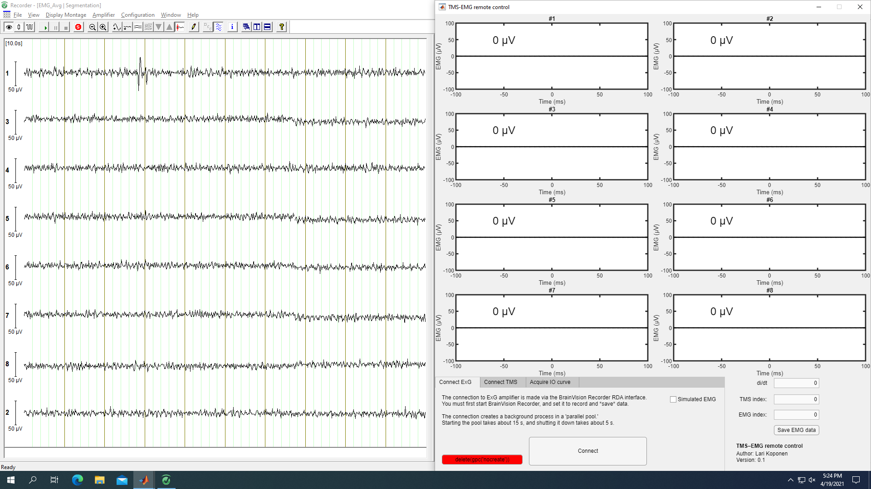
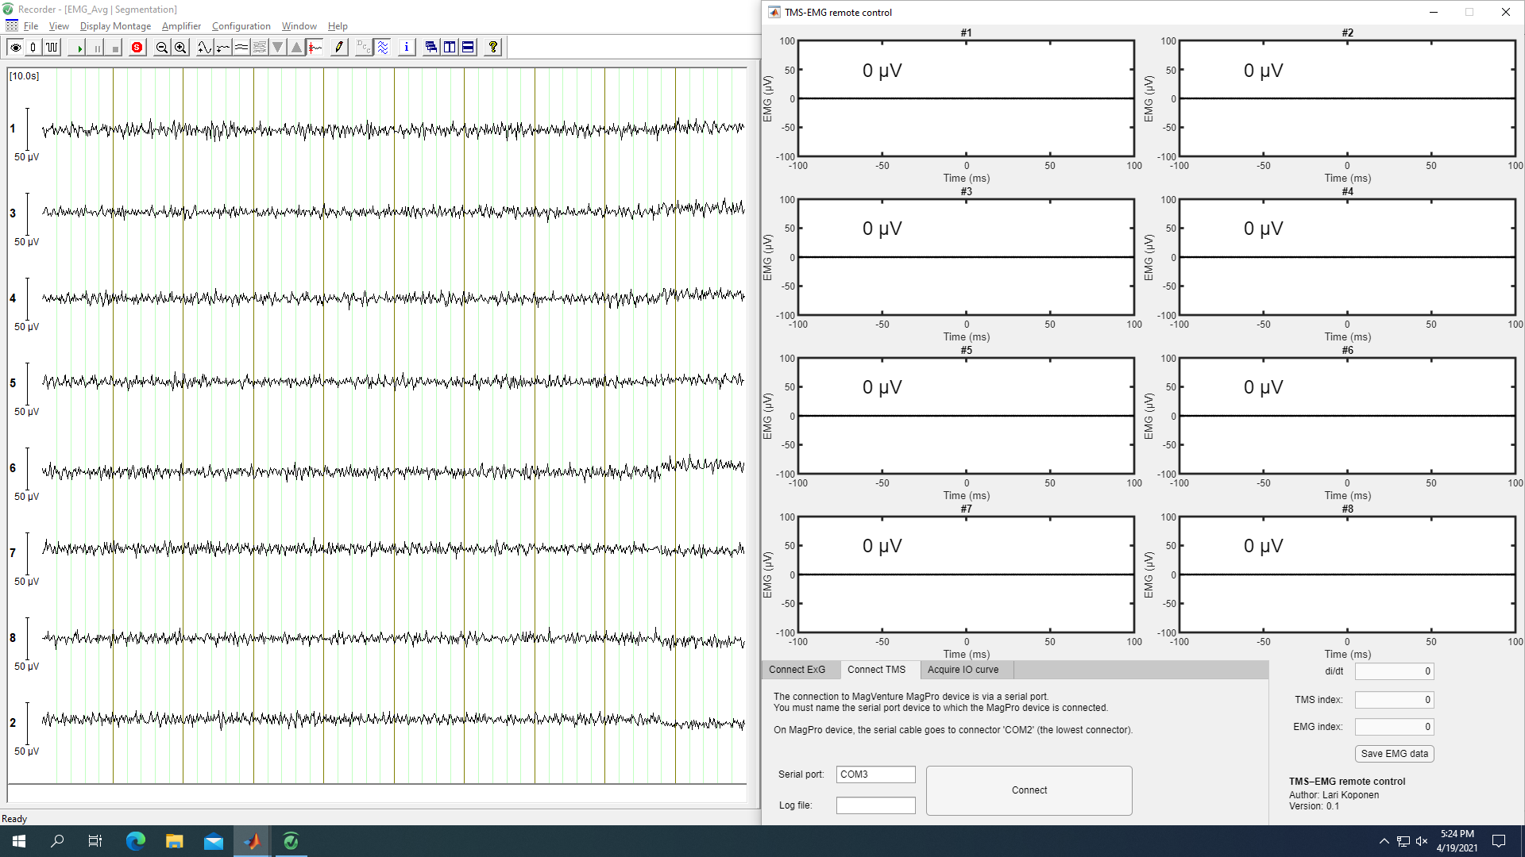
Usage 3/5
Recommended use pattern
On the ‘Connect ExG’ tab, press connect
This takes 15–20 s
In case an error popup shows, about ‘Parallel Processing Toolbox’, and you are not running a second copy of the software, push the red button
On the ‘Connect TMS’ tab, name the (raw) log file for TMS pulses and press connect
In case an error popup shows, serial port is already in use (run ‘instrreset’, check device manager)

Slide 6
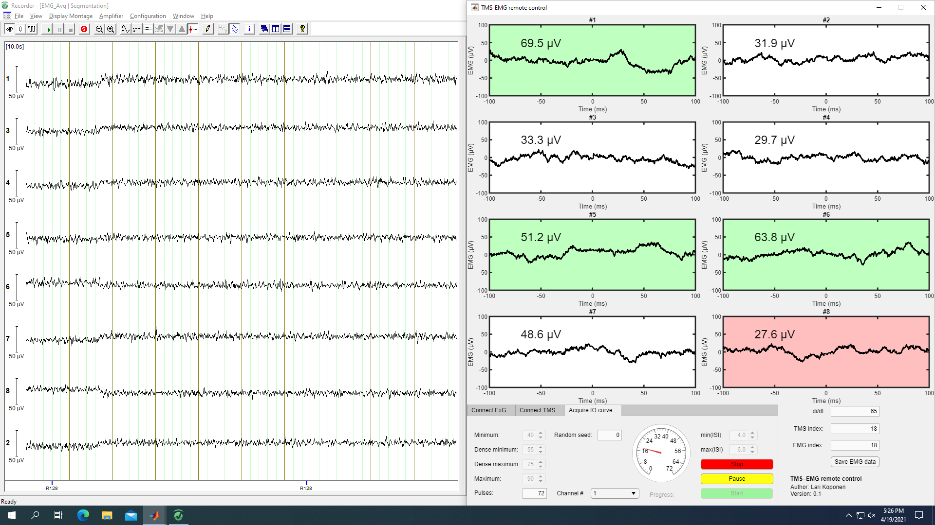
Usage 4/5
Recommended use pattern
Use ‘Acquire IO curve’ tab
One pulse per intensity between min & max
Two pulses between dense min & dense max
Random seed for pseudorandom sampling sequence (pulse are saved into the ‘EMG’ data output)
Channel number (just for note, saved to ‘EMG’ data output)
ISI, uniformly random between limits
Start: start sampling
Pause sampling (resume with start)
Stop: cancel sampling (permanently, start starts from beginning)
IO curve acquisition can be started or paused with a press of the footswitch.
The footswitch connects to the OPTIONAL trigger input box, which further (optionally) takes trigger output signal from the TMS device.
If this signal is present, the output data file will contain field ‘triggerIN’ with a ‘datetime’ object for each trigger signal by the TMS device, this data can be used to resolve the ambiguity with paired pulses
The on-line trigger counts follow the serial data, the correction is left to the user off-line, POST session
These signals are generated even if the TMS device is not connected in software, as long as the TMSEMG window is active!

Slide 7
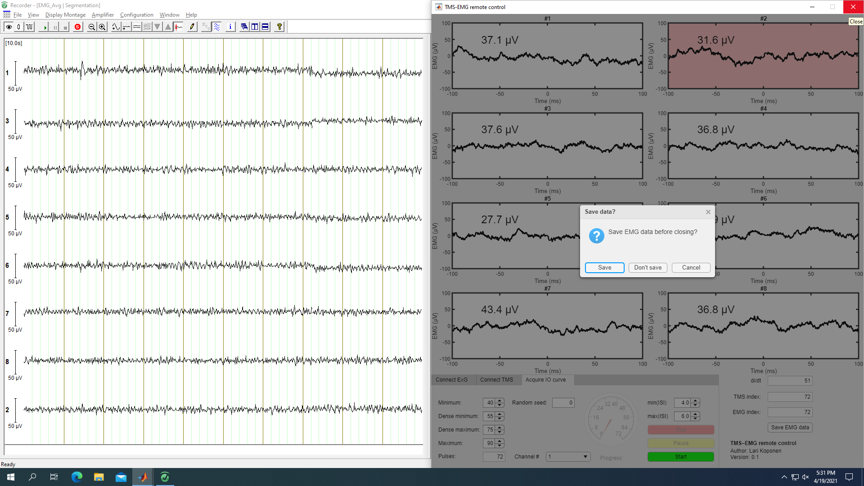
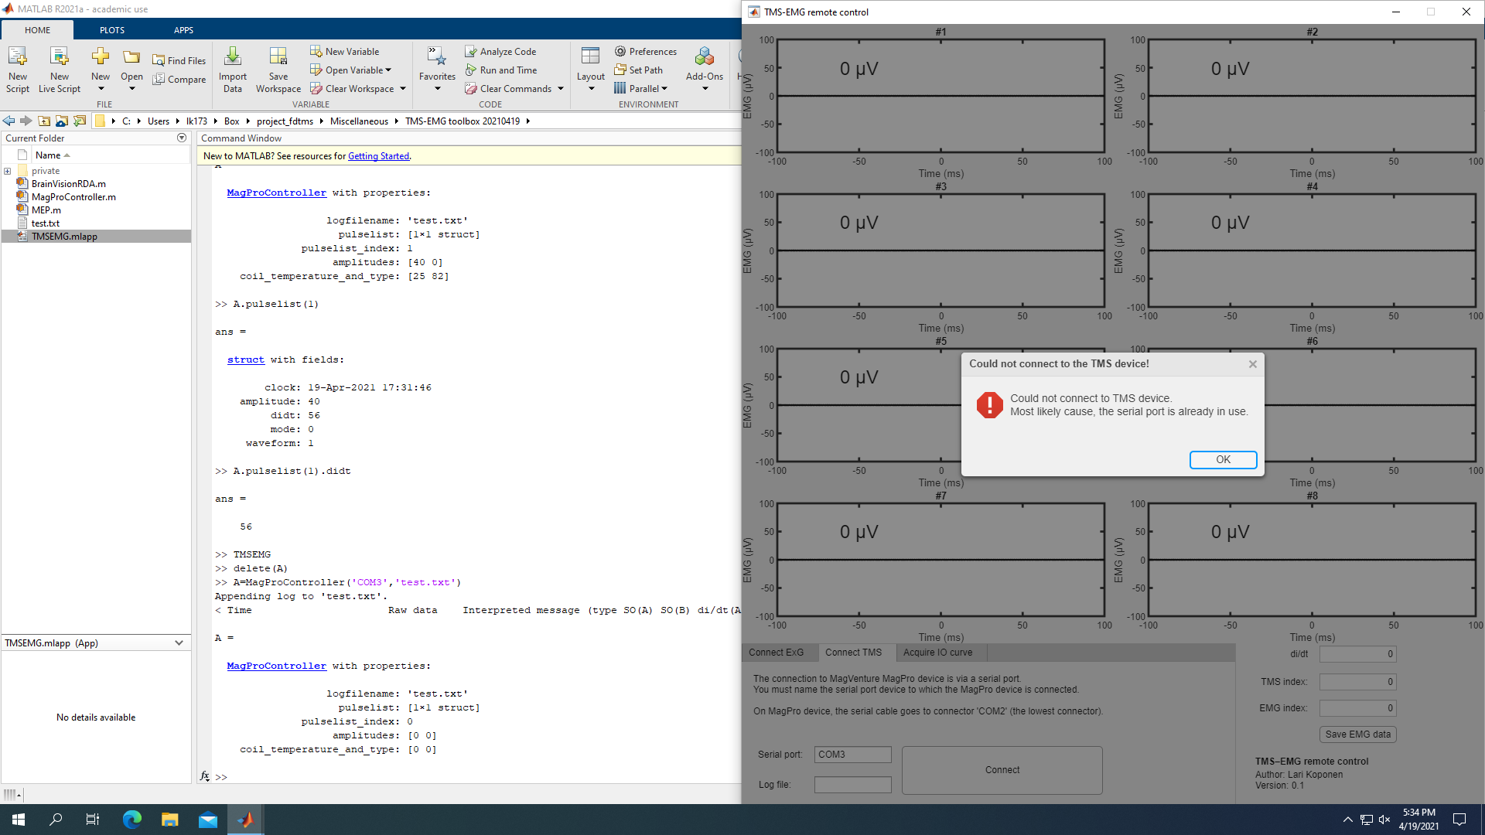
Usage 5/5
Saving data
‘Save EMG data’ button
Saves all data acquired during current session to ‘.mat’ file
If not saved, asks on close
Example of (synthetic) error
COM3 is already in use
By running the TMS device backend manually
Solvable by ‘delete()’ of that object

Slide 8
Output data formats
TMS device logfile (.txt)
Plain text of all data outputted by the TMS device
Event types 1-3, described in the MagPro user manual, have been decoded, the rest are just saved
Mostly for FYI, and for records
Contains every amplitude adjustment made on the TMS device front panel etc.
Data key provided in the class help of ‘MagProController’
EMG data file (.mat)
‘description’ the date the data was saved
‘data’, struct with cell arrays of
‘TMS’ for each TMS pulse
‘clock’ (datetime object)
‘amplitude’ (% MSO)
‘didt’ (MA/s)
‘mode’ (0=standard, 1=power, 2=twin, 3=dual)
‘waveform’ (0=monophasic, 1=biphasic, 2=halfsine, 3=biphasic burst)
‘EMG’ for each acquired epoch
{‘clock’ ‘raw data [8×2751]’ ‘filtered data [8 8×2751]’ ‘classification [8×2]’}
Data, rows of FILTERED EMG data from –0.2 to 0.2 s
Classification rows of MEP amplitude and MEP classification (1=MEP, 0=no MEP, –1=rejected trial)
‘IO’ for each started IO curve
{‘clock’ ‘pulse sequence [1×N]’ ‘TMS index at start’ ‘EMG index at start’}

Slide 9
Known limitations
Neuronavigation is not coupled to the on-line loop
Cannot do “Nexstim-like” features, like ‘trigger-only-if-coil-is-within-tolerance-of-the-correct-target’
Serial data from MagPro has undefined behavior
Dual/twin mode sends “randomly” one or two pulse messages
Case point: PP with 2.9 ms IPI sends RANDOMLY one or two messages
Solutions:
Extend BNC to PC, the triggers are deterministic
Via a parallel port (or via Arduino combining the two data streams into one…)
Make experiment specific assumptions of pulse parameters, and try to deconstruct what pulses have actually happened

